Slide 1
Introduction to LTER Information Management
John Porter

Slide 2
“If you want to understand life, don’t think about vibrant throbbing gels and oozes, think about information technology”
Richard Dawkins (1986, “The Blind Watchmaker”)

Slide 3
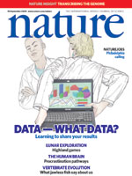
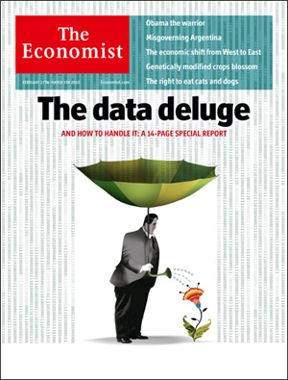

Science in a number of disciplines are recognizing that our ability to manage and assimilate massive quantities of data are a key to understanding of our world.

Slide 4
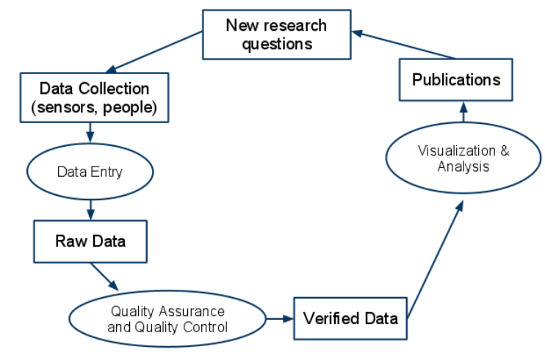
Scientific Use of Data
The traditional model of using data

Slide 5
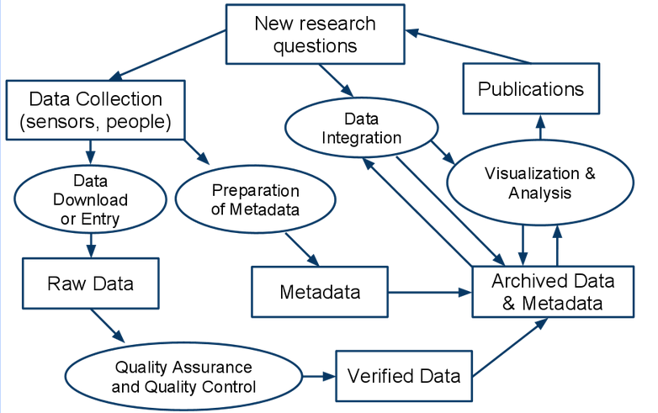
Scientific Use of Data
A new model incorporates sharing and archiving
Michiner et. al. 2011, Ecological Informatics

Slide 6
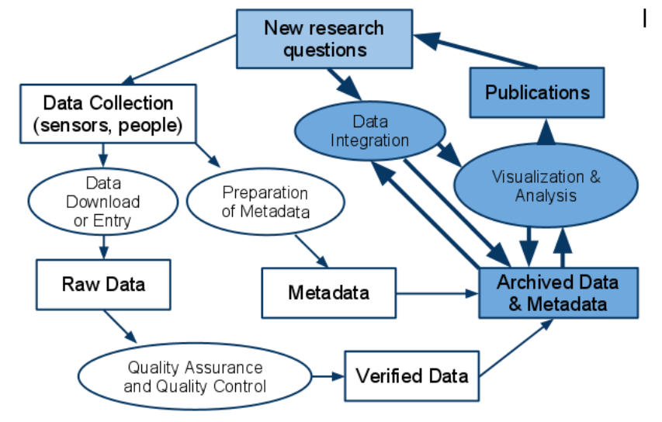
Scientific Use of Data
Archiving and sharing data provides new opportunities for better understanding our environment

Slide 7
LTER Network Vision, Mission and Goals
Network Vision: A society in which exemplary science contributes to the advancement of the health, productivity, and welfare of the global environment that, in turn, advances the health, prosperity, welfare, and security of our nation.
Network Mission: To provide the scientific community, policy makers, and society with the knowledge and predictive understanding necessary to conserve, protect, and manage the nation's ecosystems, their biodiversity, and the services they provide.
The LTER Executive and Coordinating Committee have developed a set of Network Goals, and is creating a prioritized set of Objectives, Tasks and Metrics under each of those Goals.
Understanding: To understand a diverse array of ecosystems at multiple spatial and temporal scales.
Synthesis: To create general knowledge through long-term, interdisciplinary research, synthesis of information, and development of theory.
Information: To inform the LTER and broader scientific community by creating well-designed and well -documented databases.
Legacies: To create a legacy of well-designed and documented long-term observations, experiments,and archives of samples and specimens for future generations.
Education: To promote training, teaching, and learning about long-term ecological research and the Earth’s ecosystems, and to educate a new generation of scientists.
Outreach: To reach out to the broader scientific community, natural resource managers, policymakers,and the general public by providing decision support, information, recommendations and the knowledge and capability to address complex environmental challenges.

Slide 8
LTER Information Management
Enabling NEW SCIENCE
Beyond the single investigator
Global and Regional Studies
Long-Term Studies
Resources for LTER Science
Resources for the larger scientific community
Posterity – leaving behind a legacy of resources for future researchers
Notes:
There are some types of scientific analyses where a single individual or group can’t collect all the needed data

Slide 9
Slide from James Brunt
Increasing value of data over time
Serendipitous
Discovery
Inter-site
Synthesis
Data Value
Gradual Increase
In Data Equity
Methodological Flaws,
Instrumentation
Obsolescence
Non-scientific
Monitoring
Time
Notes:
The coupling of comprehensive metadata with data generally facilitates the gradual increase in value of a data set over time. In some cases, well-documented data will lead to an important serendipitous discovery whereby the data rapidly accrue new value. Similarly, utilization of documented data for an intersite synthesis project (e.g., broad-scale comparison) can increase the value of a particular data set for both the short term and long term. In contrast, however, well-documented data can lose value. For instance, discovery of methodological flaws or obsolescence of instruments may render a data set worthless. Likewise, monitoring without a clear scientific objective can lead to a data set that atrophies over time.

Slide 10
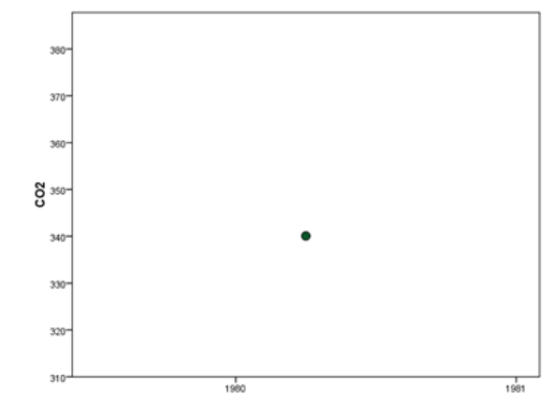
Long-Term Data
The Invisible Present John Magnuson http://limnology.wisc.edu/personnel/magnuson/articles/magnuson_biosci_v40-7-495.pdf
A single data point from the spring of 1980
Charles D. Keeling established a station of continuous CO2 monitoring on Mona Loa in 1958
Notes:
With a single data point we can make only limited conclusions. Knowing that CO2 levels were 340 parts per million tells us that CO2 is a relatively minor constituent of our atmosphere, but it does not tell us anything about variation

Slide 11
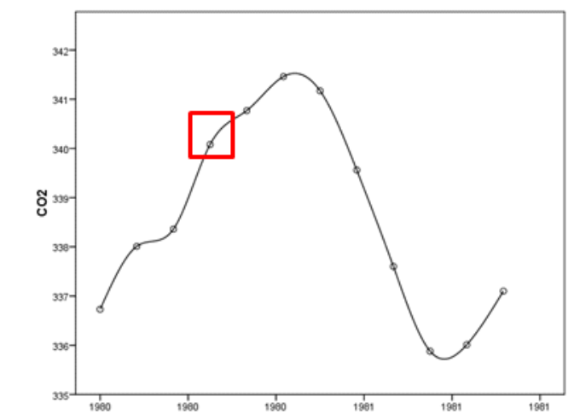
The Invisible Present
Notes:
A seasonal cycle is clearly present

Slide 12
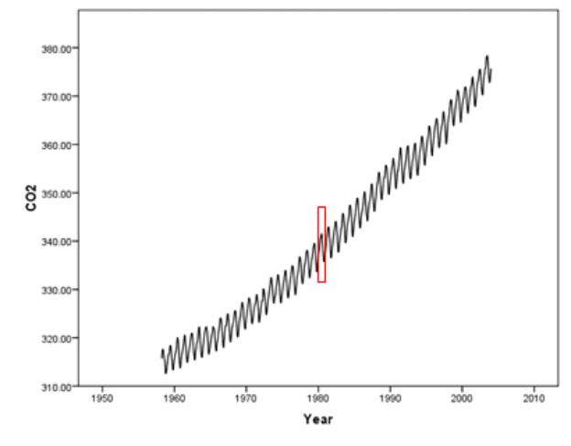
The Invisible Present
Notes:
Long-Term Data gives us a new perspective
Others have proposed that there is also an “invisible place.” So we need to have a broader context for understanding place-based measurements

Slide 13
Challenges for LTER Information Management
Keeping information organized is a fight against Entropy – the tendency for systems to become disorganized (2nd law of thermodynamics)
Technological Challenges
Semantic Challenges
Cultural Challenges

Slide 14
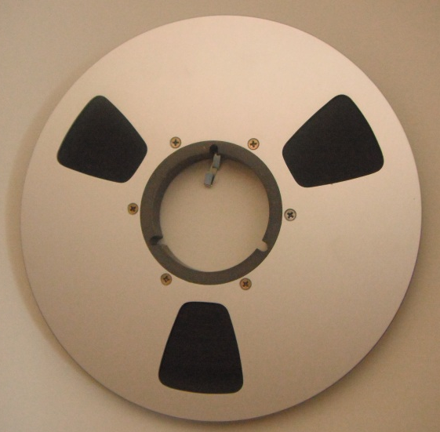
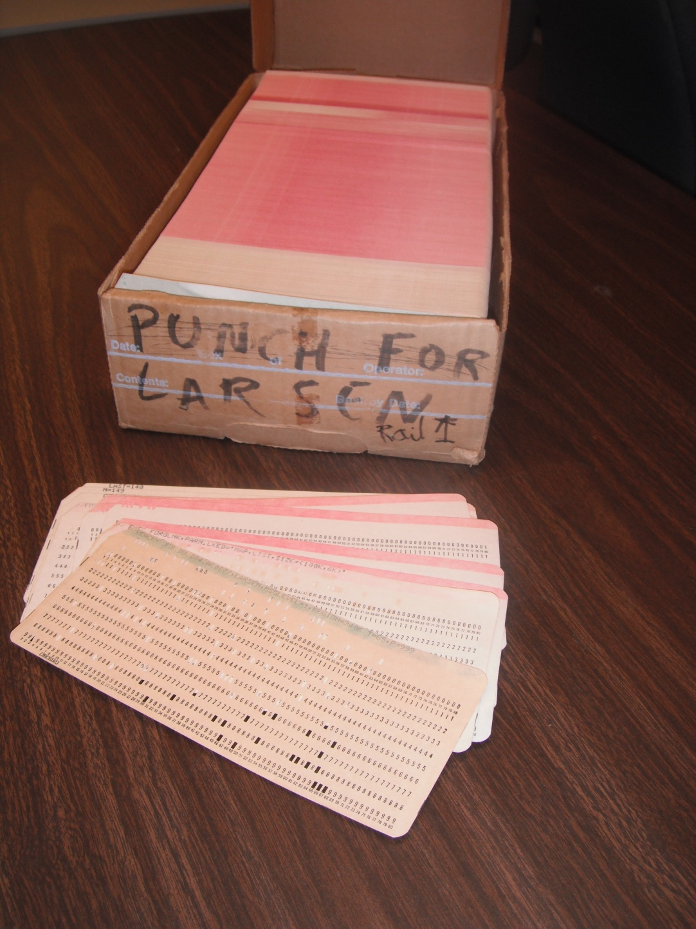
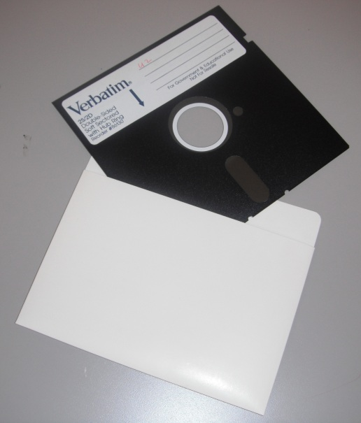
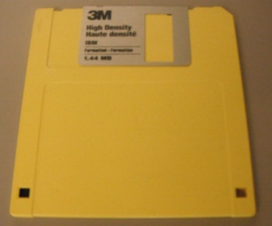
Challenge: How do you deal with technological change?
Text – ASCII, EBCDIC & Unicode
Lotus 1-2-3 VisiCalc
Word Perfect Wordstar
DBase III Quatro-Pro
Word MacOS
Excel Windows
Access DOS
XML Linux

Slide 15
LTER Solutions
When possible employ widely-used, generic forms for archival storage of data
Data tables in comma-separated-value files using ASCII or UNICODE text
Periodically convert older proprietary formats that can’t be stored in a generic form (e.g. GIS data)
Periodically migrate physical media (cards ⇒ tape ⇒ DVD)
Forge relationships with other organizations (e.g. DataONE)
Add “energy” to the system: Invest in information managers and information management systems that continuously manage data

Slide 16
Challenge: Understanding Data
Without Metadata, the usable information content of data declines over time
Time of publication
Specific details
General details
Retirement or
career change
Information Content
Accident
Death
Time
Michener et al. 1997. Ecological Applications

Slide 17
LTER Solutions
Standardized Metadata – Ecological Metadata Language (EML)
Site and Network Tools for creation of EML
Network-Wide Data Catalog
PASTA system for Provenance –Aware metadata for derived data products

Slide 18
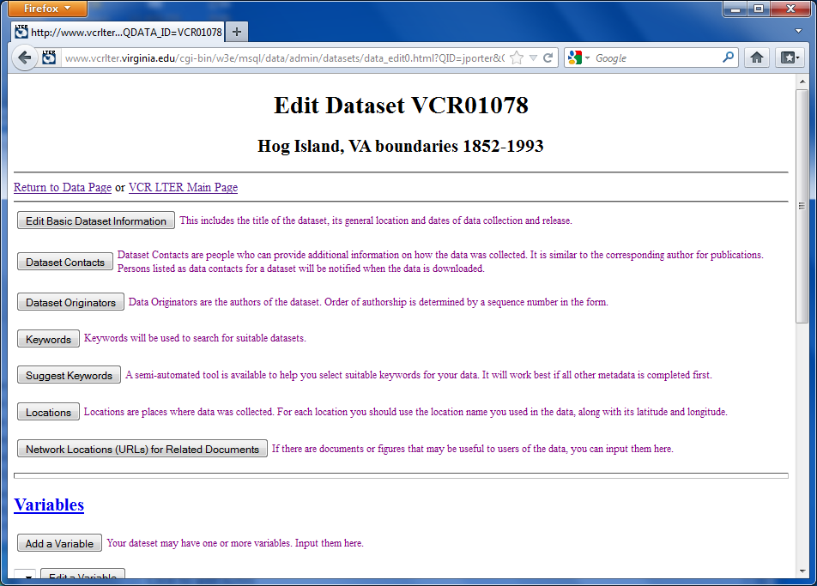
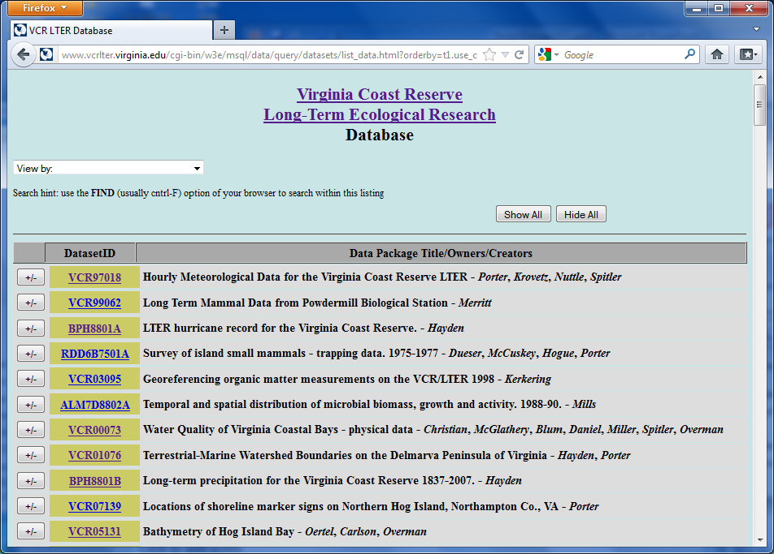
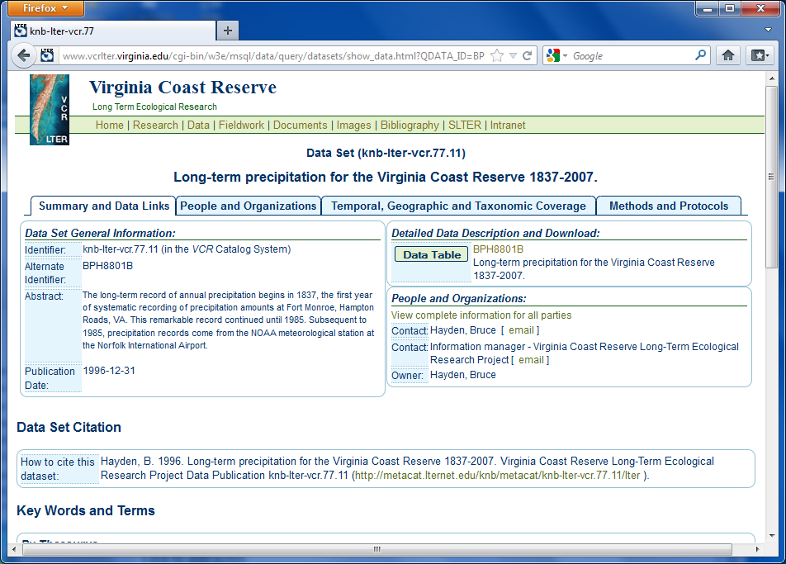
Web forms allow us to create standard “Ecological Metadata Language” (EML) data using a metadatabase

Slide 19
“Cultural” Challenges
Unfamiliarity with Sharing Data
Incentives for sharing data
Lack of expertise in:
Advanced tools for managing and integrating data
Quality Control and Assurance
creating archival-grade datasets

Slide 20
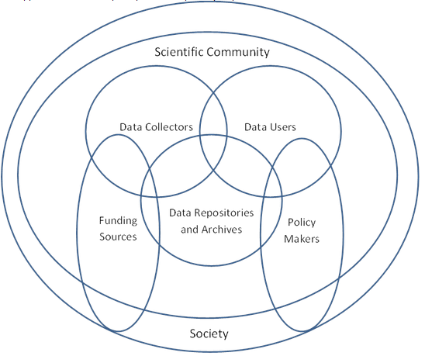
Data Sharing and Archiving
Notes:
Lots of “players” when it comes to data sharing – with different needs and opportunities.
The importance of data is being increasingly recognized
For example, the National Science Foundation now requires a “Data Management Plan” be included in each proposal.

Slide 21
LTER Solutions – Data Sharing
The LTER Network Data Policy dictates that almost all data should be made available within 2-years
exceptions must be justified
NSF and Renewal Panels pay close attention to whether sites are adhering to the policy.
Data Availability ⇒ Funding!

Slide 22
Additional Incentives
NSF now requires Data Management Plans for non-LTER data as well
A better plan increases your chance of funding
Journals are increasingly requiring data submission as a condition of publication for papers (e.g,., evolution, genomics journals)
Increasingly data is citable
Allows you to tally the citations of your data as well as citations of your publications
Data can even be published: e.g., Ecological Archives publishes “data papers” that are peer-reviewed
Notes:
To some degree, participants in the LTER Network have the advantage that they can leverage site and network systems.

Slide 23
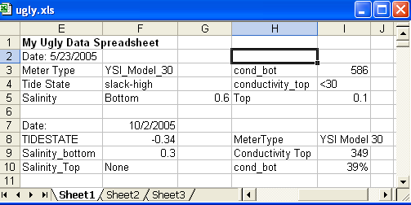
Challenge
The ways researchers typically use data are frequently not compatible with best practices for archiving

Slide 24
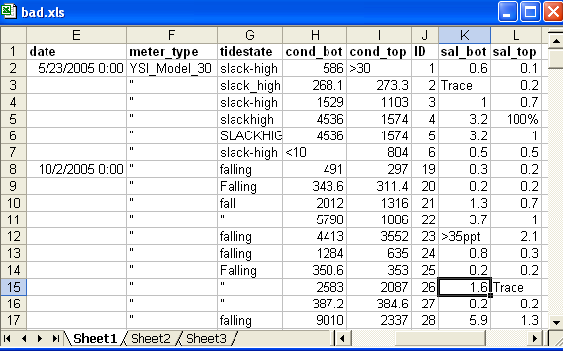
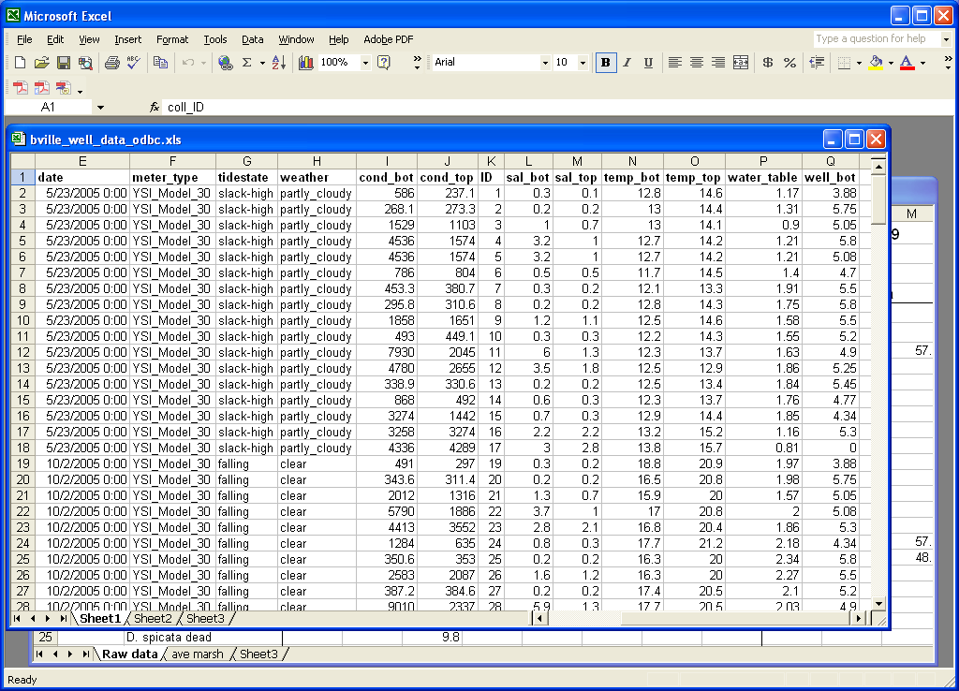
LTER Solutions
Site IM’s help vet or prepare data
Help communicate best practices to students and investigators
Use of improved tools that encourage good practices
Don’t Ever Sort this!!!!!!
Complete lines are OK to Sort

Slide 25
Useful Tools
Databases (e.g., mySQL, ACCESS, SQLite, PostgreSQL)
Geographical Information Systems (GIS)
Statistical Packages (e.g., R, SAS, SPSS, Matlab)
Metadata Editors (e.g., Morpho)
Programming Languages (e.g., Python, C++, Java, FORTRAN)
Scientific Workflow Systems (e.g., Kepler, VisTrails, Taverna)

Slide 26
The DataONE Data Life Cycle
Assure
Preserve
Discover
Integrate
Analyze
Collect
Describe
Plan
Notes:
The creation, management and use of data is a multi-faceted process, with opportunities and challenges at each step. But ultimately, shared data will allow us to understand the world in a way that is otherwise not possible. Our challenge is:
Can we make information available to ecologists:
In ways they can locate the information they need?
With information in forms they can readily use?
How can we assure that the information is current and accurate?

Slide 27
The DataONE Data Life Cycle
Assure
Preserve
Discover
Integrate
Analyze
Collect
Describe
Plan
Design of forms, databases or other data structures,
Capture of digital information
Notes:
The creation, management and use of data is a multi-faceted process, with opportunities and challenges at each step. But ultimately, shared data will allow us to understand the world in a way that is otherwise not possible. Our challenge is:
Can we make information available to ecologists:
In ways they can locate the information they need?
With information in forms they can readily use?
How can we assure that the information is current and accurate?

Slide 28
The DataONE Data Life Cycle
Assure
Preserve
Discover
Integrate
Analyze
Collect
Describe
Plan
In the “traditional” model, we would jump to Analyze here…
Quality Control
Quality Assurance
Avoid “Garbage In, Garbage Out”
Notes:
The creation, management and use of data is a multi-faceted process, with opportunities and challenges at each step. But ultimately, shared data will allow us to understand the world in a way that is otherwise not possible. Our challenge is:
Can we make information available to ecologists:
In ways they can locate the information they need?
With information in forms they can readily use?
How can we assure that the information is current and accurate?

Slide 29
The DataONE Data Life Cycle
Assure
Preserve
Discover
Integrate
Analyze
Collect
Describe
Plan
Production of Metadata
Who, what, when, where why and how
Form of data
Submission to an Archive
Notes:
The creation, management and use of data is a multi-faceted process, with opportunities and challenges at each step. But ultimately, shared data will allow us to understand the world in a way that is otherwise not possible. Our challenge is:
Can we make information available to ecologists:
In ways they can locate the information they need?
With information in forms they can readily use?
How can we assure that the information is current and accurate?

Slide 30
The DataONE Data Life Cycle
Assure
Preserve
Discover
Integrate
Analyze
Collect
Describe
Plan
Reuse of data to produce new scientific insights
Notes:
The creation, management and use of data is a multi-faceted process, with opportunities and challenges at each step. But ultimately, shared data will allow us to understand the world in a way that is otherwise not possible. Our challenge is:
Can we make information available to ecologists:
In ways they can locate the information they need?
With information in forms they can readily use?
How can we assure that the information is current and accurate?

Slide 31
Data Reuse
For data reuse, the greatest opportunities will be presented by exceptional data
High quality
Useful transformations
Excellent metadata
Integration with other data
Similar data from other places or times
Different kind of data that add additional value when interpreting data
Gap-filled, extensive QA/QC

Slide 32
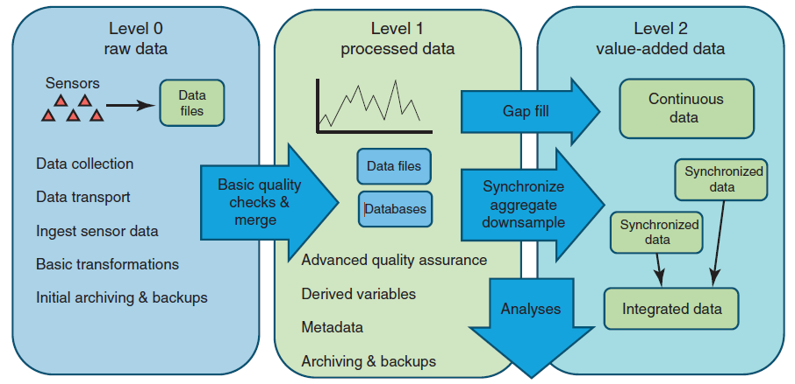
Archiving and Publishing Data
Porter, Hanson and Lin, TREE 2012
Notes:
Most field ecologists are focused on “level 0” data – but the greatest opportunities for shared data are for higher-level data products. The Level 1 and Level 2 data are what are likely to be most in demand.

Slide 33
Next Steps
Learn one or more advanced tools for manipulating data
Databases
GIS
Statistical software
Computer languages
Collect some data and conduct a quality assurance analysis on it
Prepare Metadata and submit data to an archive
Search data archives for related data that can be integrated with your data to reach a wider array of conclusions

Slide 34
Questions????
“Applied computer science is now playing the role which mathematics did from the seventeenth century through the twentieth century; providing an orderly, formal framework and exploratory apparatus for other sciences.” -George Djorgovski Professor of Astronomy, Caltech (http://doi.ieeecomputersociety.org/10.1109/CAMP.2005.53 )

